Slide 1
WOBBY
For a dynamic sitting

Slide 2
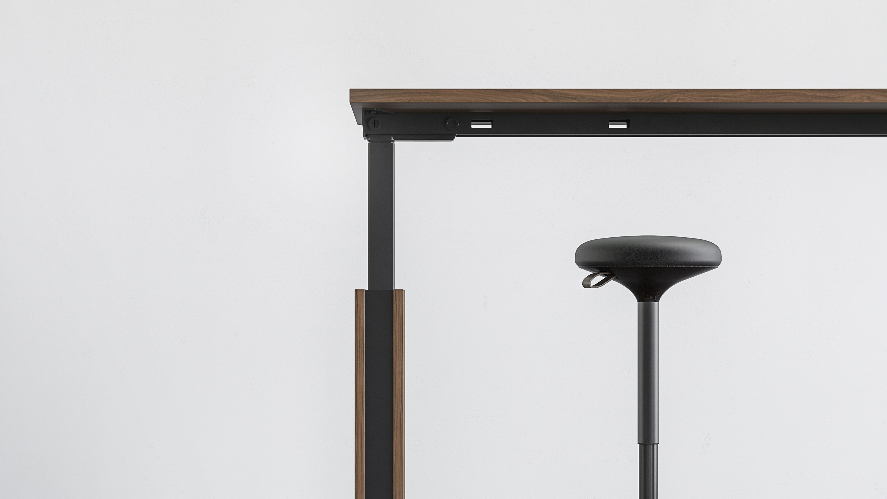
WOBBY pivoting stool - a solution for better productivity at work
Notes:
A prolonged work that involves a lot of sitting inevitably causes discomfort and has a negative impact on our productivity. Therefore, more and more modern offices are being set up to create the most efficient and healthy work environment possible. For this reason, we present to you the WOBBY pivoting stool - a solution that will help you feel better at work.

Slide 3
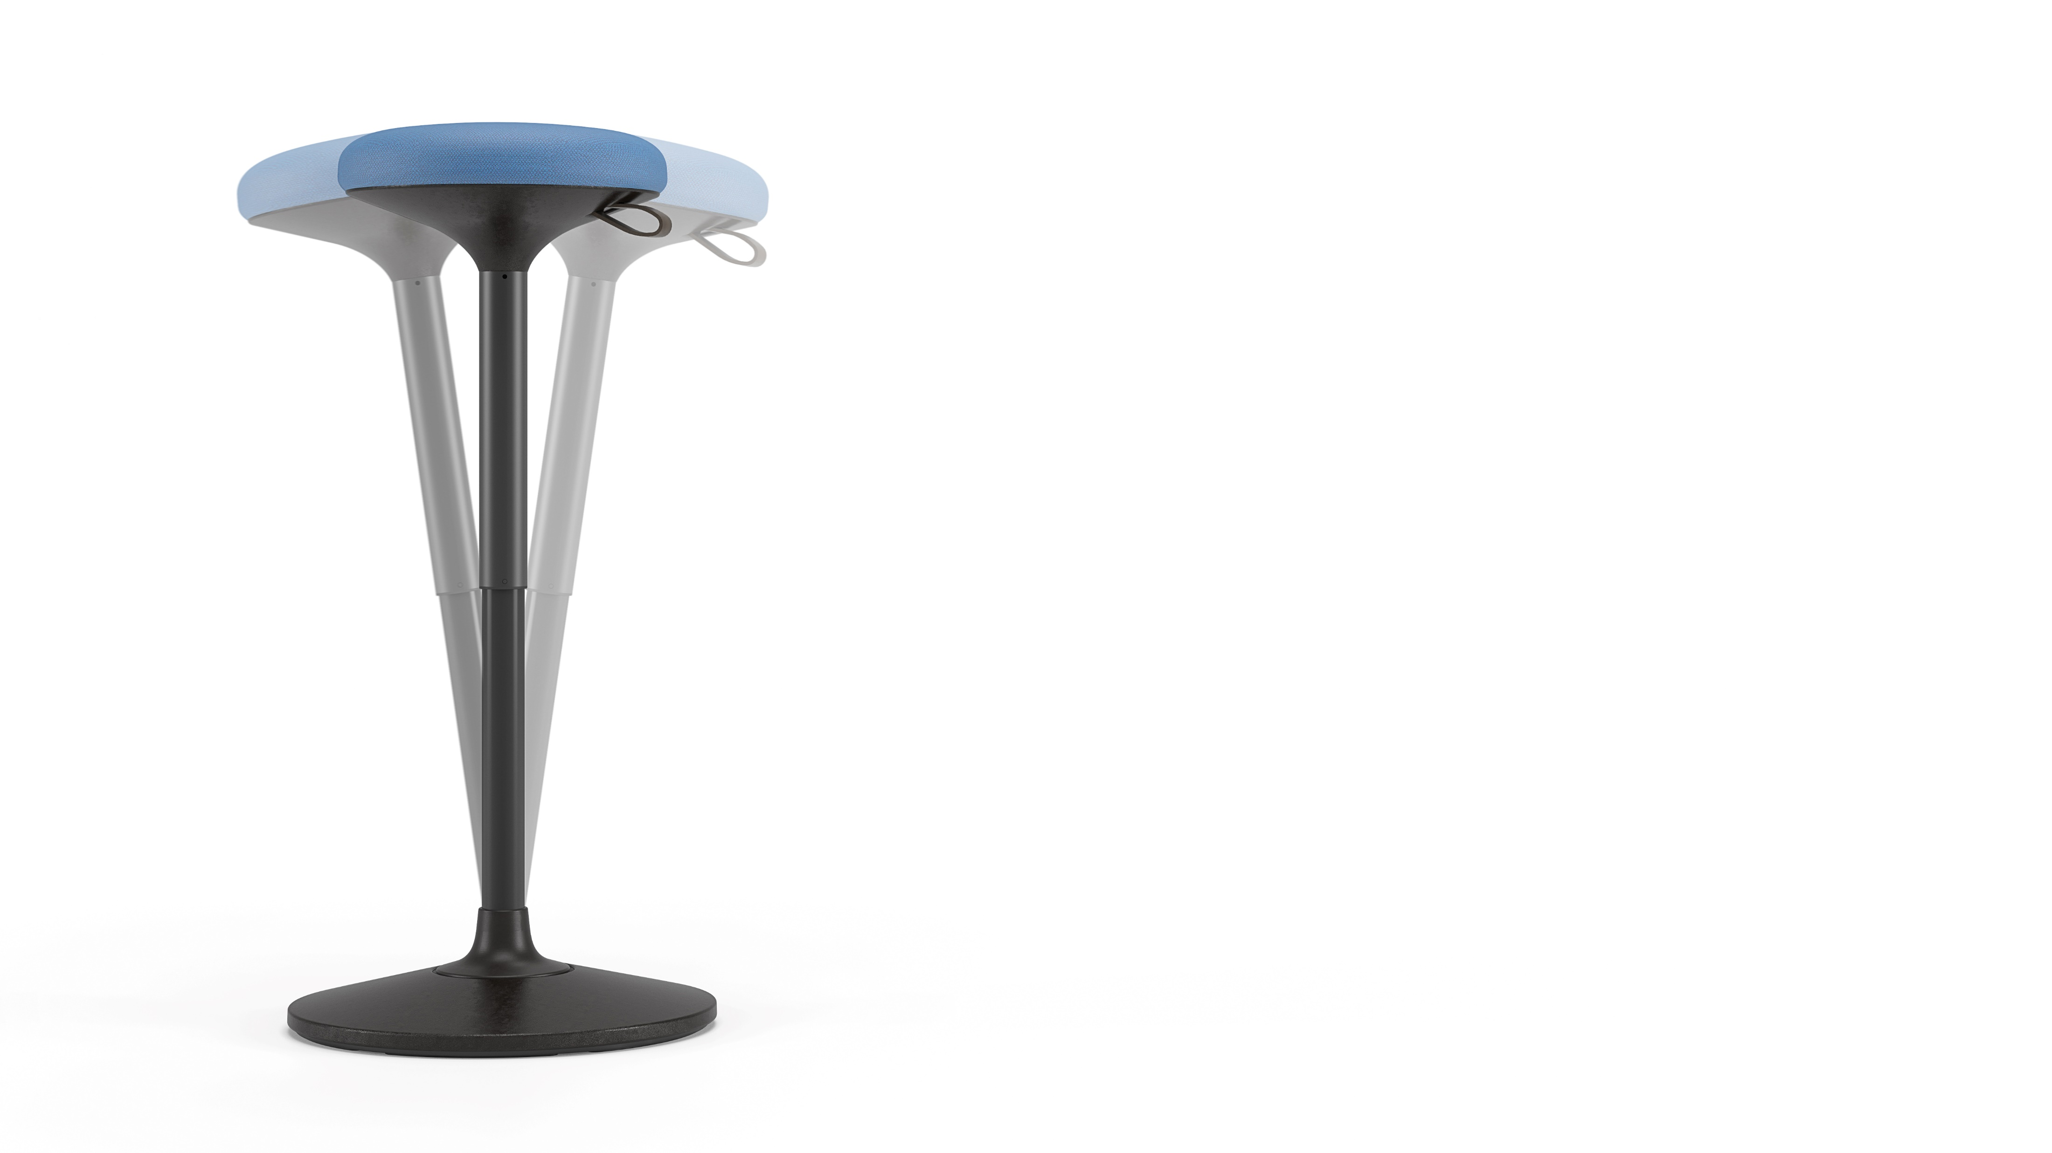
Your best office partner
A healthier sitting alternative
Perfect for dynamic work environment
Can be used as a support when standing
A modern and sleek design
Notes:
The WOBBY pivoting stool is a great choice for those looking for healthier sitting alternatives. It is a perfect active sitting solution for dynamic work and cooperation areas. The upper part of the stool swings and moves together with its user, so it can also be used as a support when standing. This allows you to change the position of the body at the workplace throughout the day without distracting from important tasks. Due to its modern and sleek design, this balance chair will fit into any contemporary office space.

Slide 4
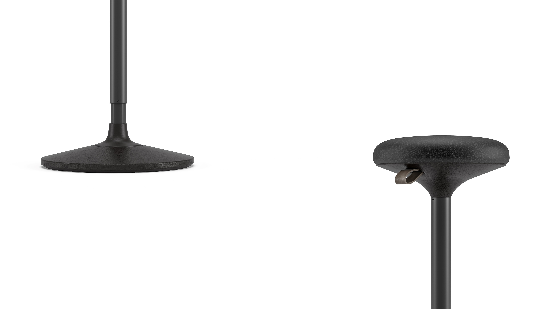
A Unique pivoting system
The seat can be tilted up to 8 degrees in all directions and rotated 360 degrees
A stable, non-skid base surface
An elegant brown leather strap for seat height adjustment
Notes:
The distinctive feature of this chair is its unique pivoting system, hidden inside an elegant black plastic base. With the help of this system, the seat can be tilted up to 8 degrees in all directions and rotated 360 degrees. Having a non-skid surface, the base of the stool will always remain stable, while the high-quality materials will ensure safe and long-lasting use.

Slide 5
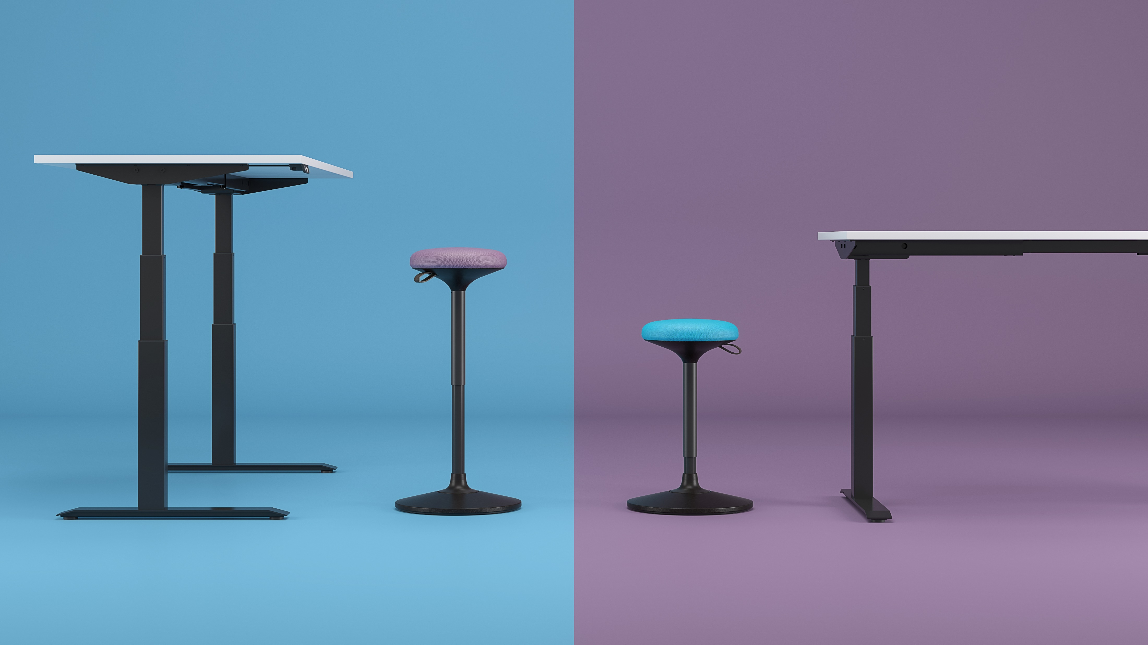
Adjust the seat height to your individual needs
MAX
850 mm
MIN
600 mm
Notes:
A pneumatic lift mechanism lets you fine-tune the perfect level for different work surface heights. Adjustable seat height range from 60cm to 85cm, so you can smoothly adjust from sit to stand position in seconds. Changing body positions regularly makes your work more efficient and creative even when working long hours.

Slide 6
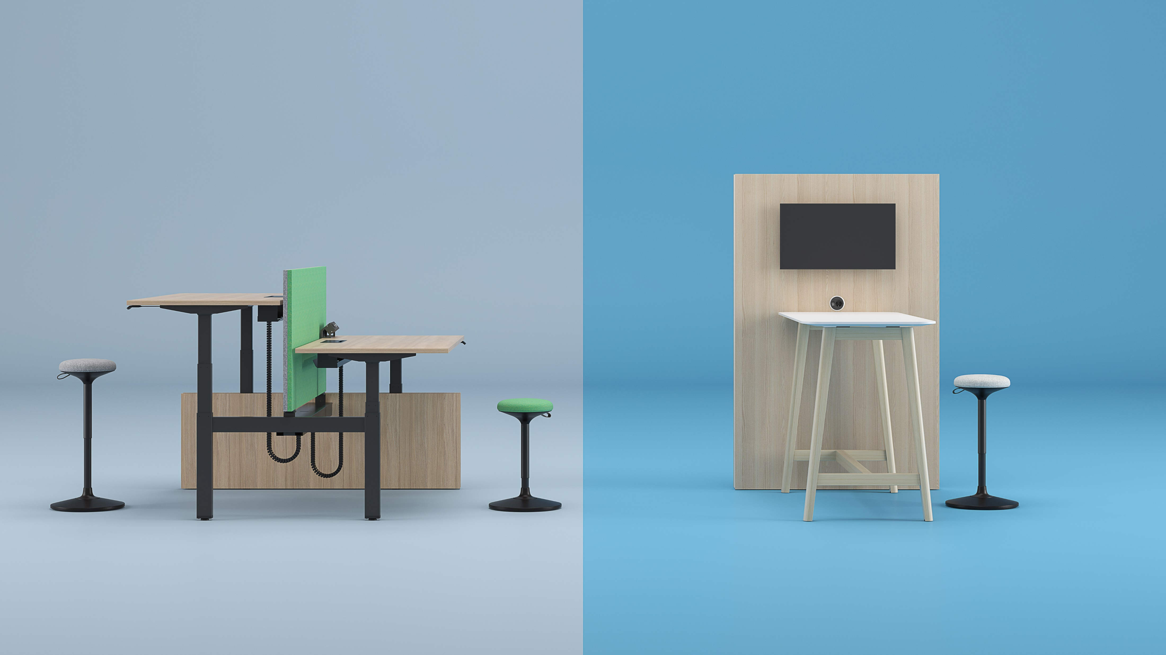
The WOBBY pivoting stool can be easily fit to the height-adjustable desks, as well as high or conference tables
Notes:
The WOBBY pivoting stool can be easily fit to the height-adjustable desks, as well as high or conference tables.

Slide 7
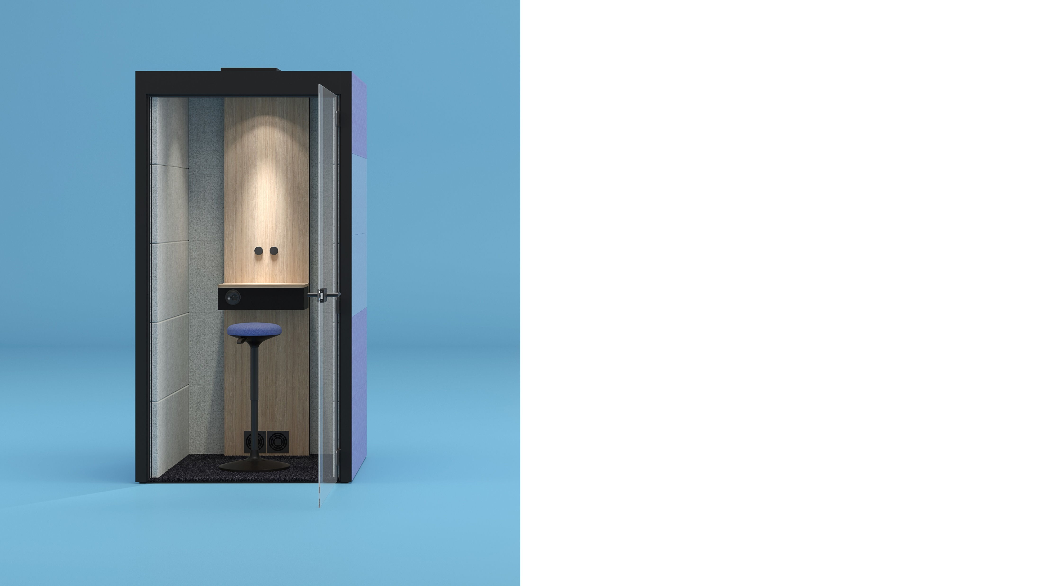
Due to its compact size, this chair is perfect for different size SILENT ROOM acoustic furniture or small meeting rooms
Notes:
Due to its compact size, this chair is also perfect for different size SILENT ROOM acoustic furniture or small meeting rooms.

Slide 8
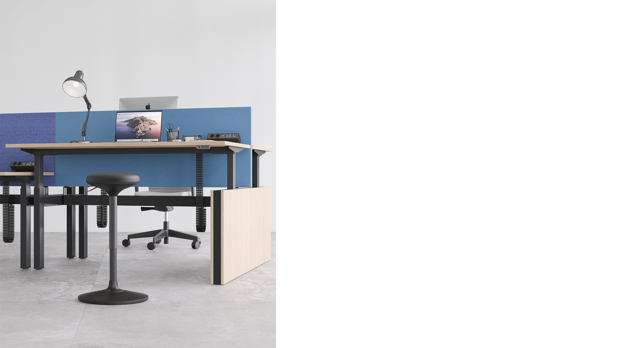
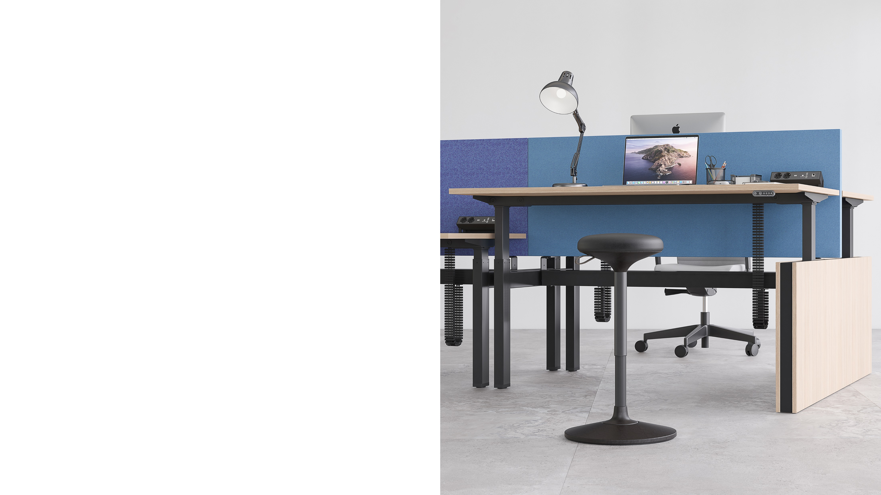
WOBBY

Slide 9
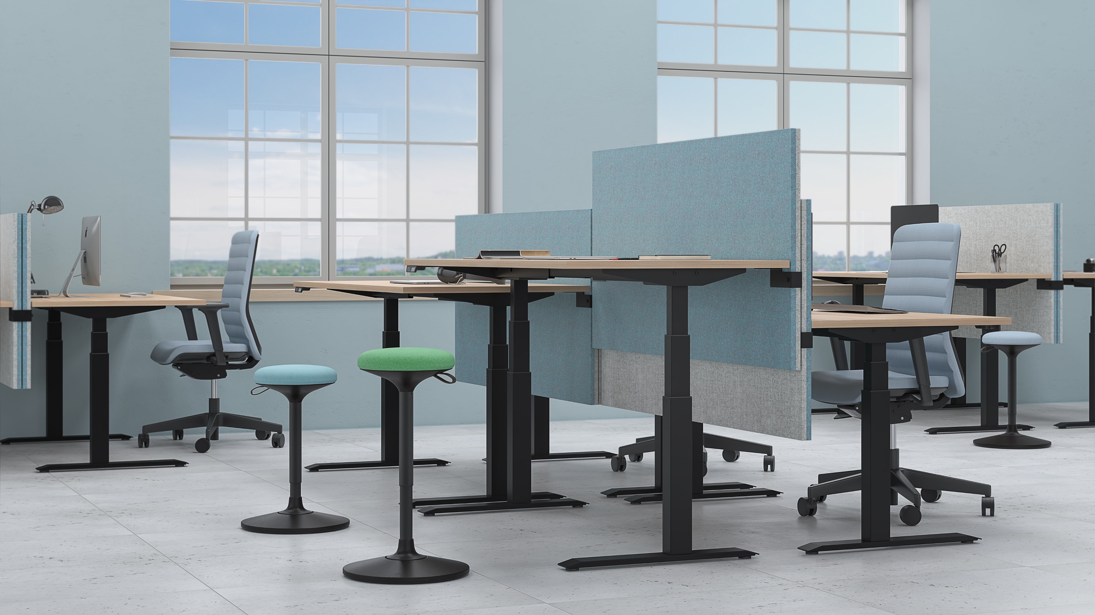

Slide 10
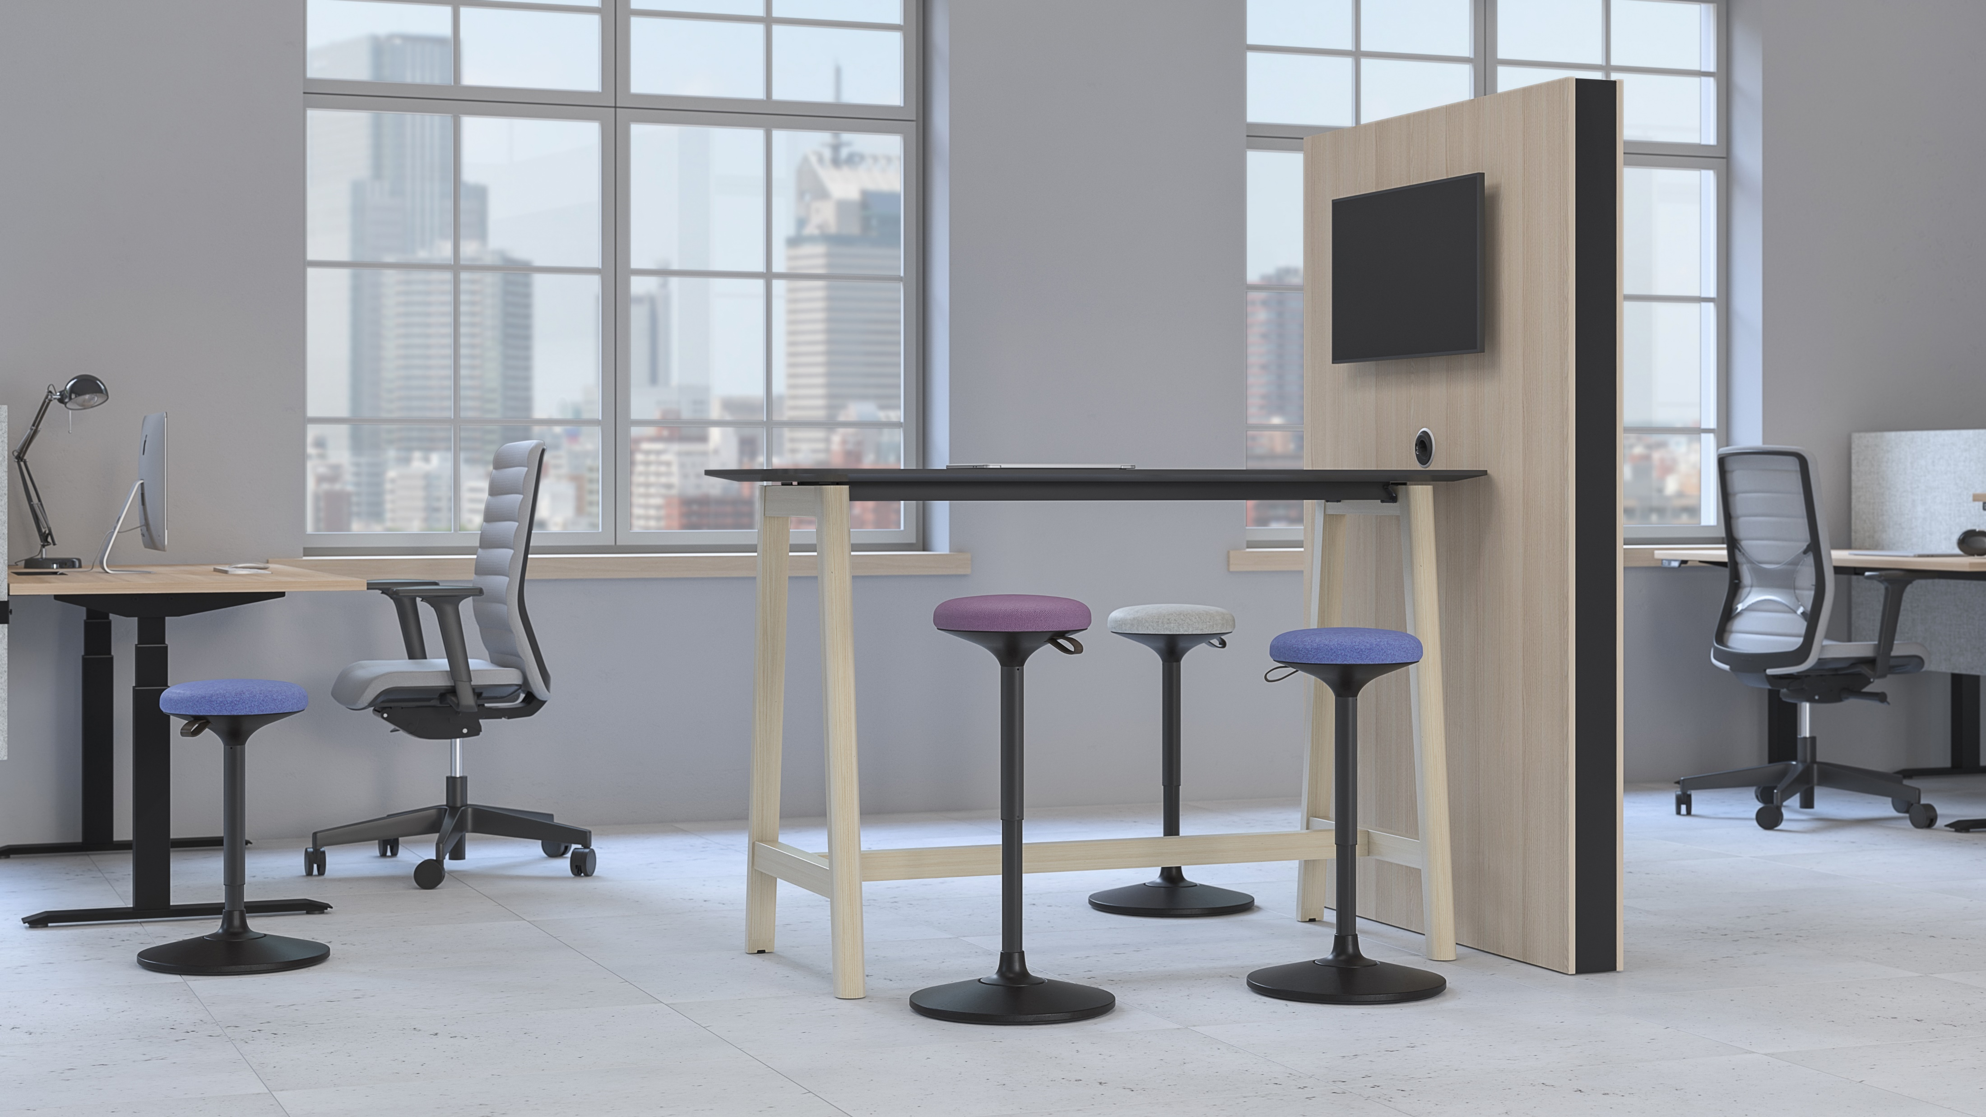

Slide 11
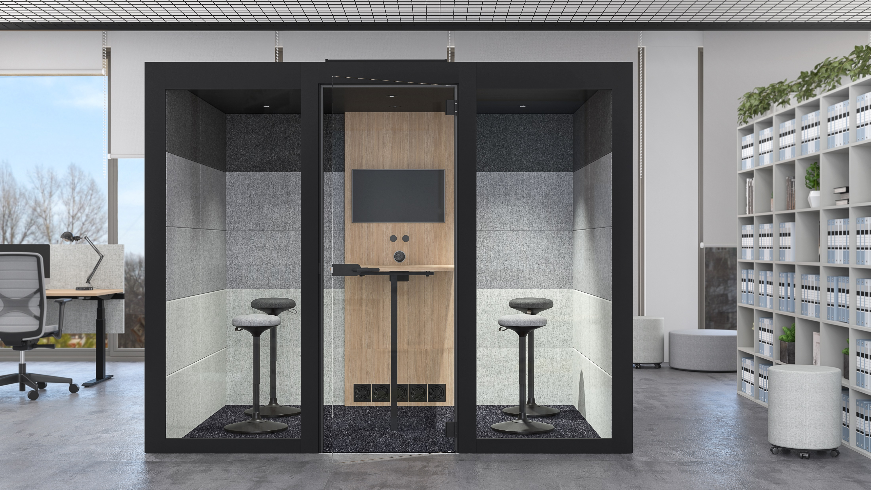

Slide 12
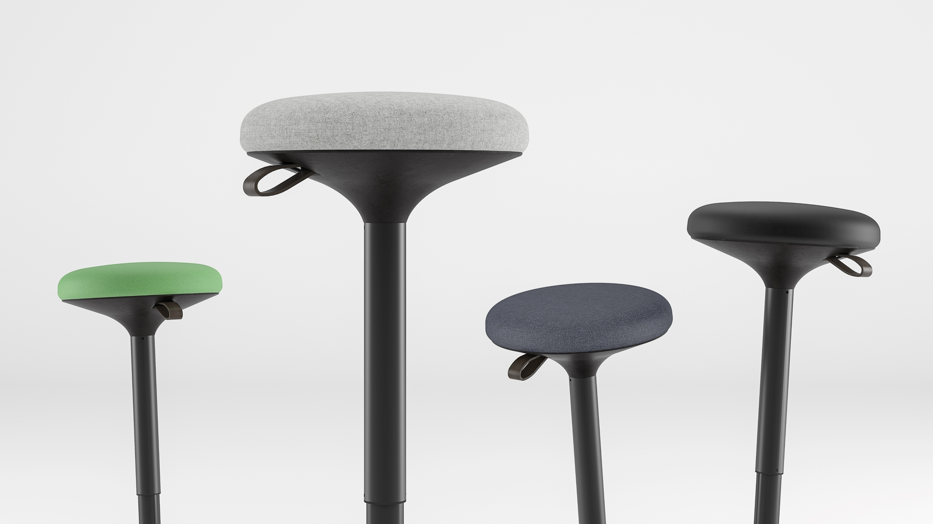
Choose your office mood
Notes:
The seat of the stool is made of polyurethane and can be upholstered in a wide selection of fabric, genuine leather, and leather look. By choosing the most suitable colors, you will give this balance chair the desired character and easily adapt to existing office interior solutions.

Slide 13
